Slide 1
Resume Scoring Using NLP
Presented By:
Chetan Niloor Batch: BA04- R18MBA58

Slide 2
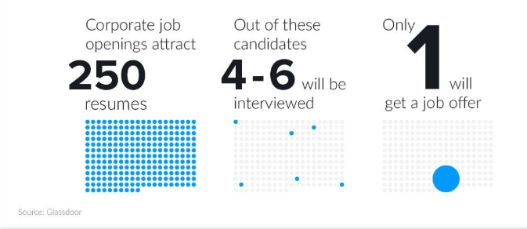
Business Understanding
The objective of the project is to create a Resume Scoring algorithm using Natural Language Processing.
The algorithm will parse resumes one by one and will create a Candidate Profile based on the skills mentioned in the resume.

Slide 3
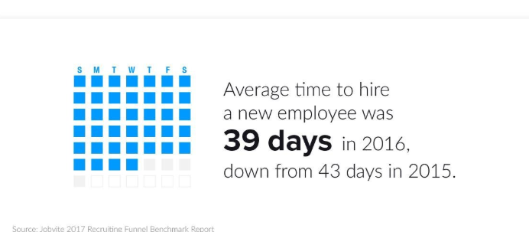
Problem Statement
Finding the right candidates to organisation has been the major problem to HR in recruitment.
It takes immense amount of time and accuracy is very less to get the right candidate, so we are building the NLP model to get through this issue.

Slide 4
Data Understanding
Data is in the form of PDF format.
Resumes are downloaded directly from Job portals.
some of them resumes we have got through referrals.

Slide 5
Data Preparation
We are doing the word embedding's, however before doing embedding's data is pre-processed in a text file. It involves removal of space, stop words, digits etc.
A text file is created named commons.txt which contains all the words that occur frequently and are not useful for technical skill matching.
Creating phrases of words that frequently occur together (bigrams)

Slide 6
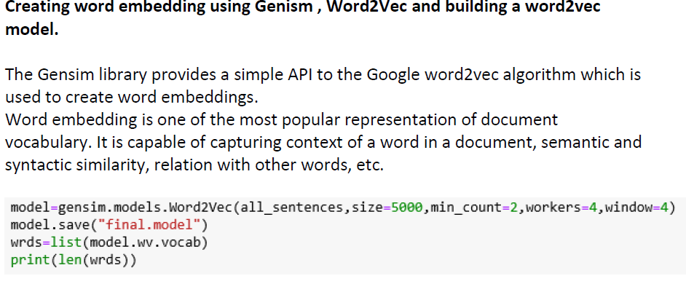
Model Information

Slide 7
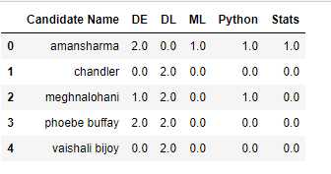
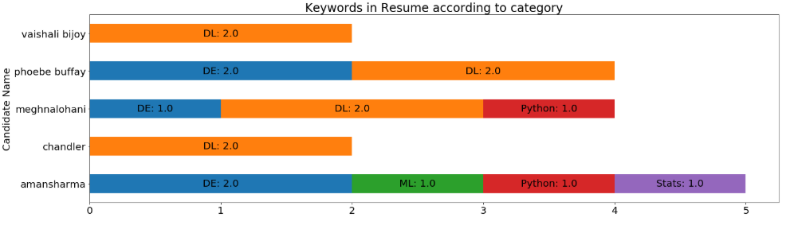
Evaluation
Counting words under each category and building the candidate profile

Slide 8
FUTURE SCOPE
Getting the resumes from online job portals and parsing them with social networking sites will enhance the accuracy and reduce the time and cost to hire the right candidates.
With a better refined corpus, the model can be made more accurate.

Slide 9
Thank You

